Slide 1
BCOG 100
Neural Circuits
Lecture 1: Neural Circuits in Brains

Slide 2
Reading Check 5-1
Password: circuit
Question: What’s an example of a neural circuit described in the reading?

Slide 3
Introducing Neural Circuits
Recap & Overview
Last time: Evolution of neurons & brains
Today:
How neurons work together in circuits
Why circuits? From reflexes → computation
Notes:
Last class, we looked at how neurons evolved and how they form the building blocks of brains.
Today we’re zooming in on the next level: how neurons connect to each other to form circuits.
Circuits are groups of neurons wired together in ways that let them do specific jobs —
like controlling a reflex, producing rhythmic movements like breathing or walking,
or ultimately supporting memory and thought.
This week, we’ll start with the basics — what neural circuits look like and how they function.
In our next lecture, we’ll connect those circuits to logic and computation,
and then we’ll end the week by seeing how circuits can change and learn from experience.
So today is about laying the foundation: understanding what a circuit is,
the basic wiring patterns, and why they matter for behavior.

Slide 4
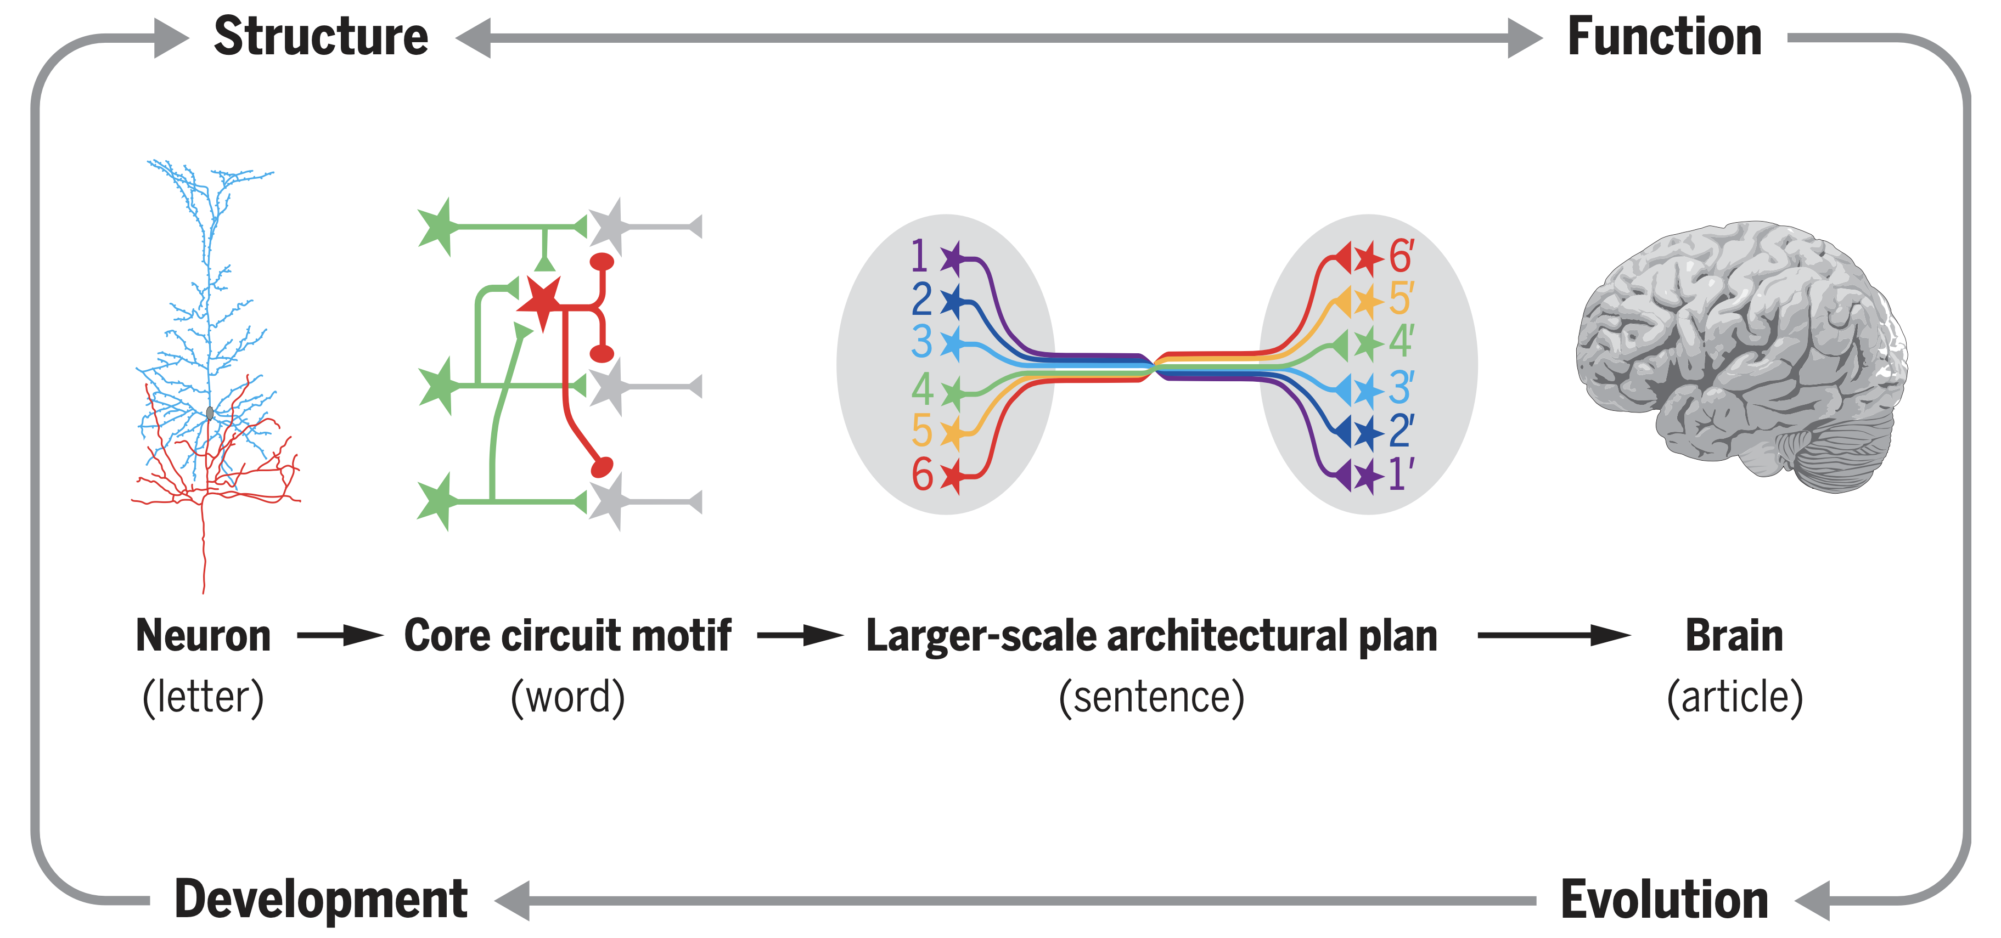
Introducing Neural Circuits
What is a Neural Circuit?
Neurons don’t act alone — they connect
Circuits = patterns of connections
“Letters → words → sentences” (Luo, 2021)
Notes:
A neural circuit is simply a group of neurons connected in a particular way so that they can carry out a function.
It’s tempting to think of neurons as the ‘basic unit’ of the nervous system, but they almost never act in isolation.
Instead, it’s the pattern of their connections that creates function.
Here’s where Luo’s article gives us a useful analogy:
If neurons are like letters in an alphabet, then circuits are like words,
and larger architectures of circuits are like sentences.
Just as the same letters can form many different words,
the same neurons — wired differently — can form circuits that do very different jobs.
So the focus of this lecture is not just the individual neurons,
but the rules and motifs of how they get put together into circuits.
These motifs will come up again and again — in reflexes, rhythms, computation, and eventually in learning.

Slide 5
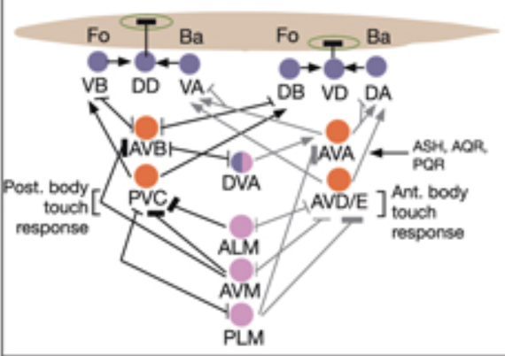
Introducing Neural Circuits
Simple Reflex Arc (C. elegans)
Input → processing → output
Example: touch reflex in C. elegans
Circuits can be simple and powerful
Escape Circuits
Circuits can trigger rapid survival behaviors
Example: C. elegans escape response
Example: human startle reflex
Mechanosensory neurons (pink) that detect touch stimuli synapse onto command interneurons (red). These, in turn, synapse onto motor neurons (purple) responsible for forward (Fo) and backward (Ba) locomotion, leading to rapid withdrawal from the stimulus. Spontaneous forward motion can be initiated by a head motor nervous system, which is partially independent of the command interneurons
Notes:
Circuits are often tuned for survival — when danger strikes, you need to act fast.
Example 1: C. elegans
Let’s take a very simple animal — C. elegans, the tiny worm we talked about last time.
It has only 302 neurons, but even with so few, it has working circuits that control behavior.
When the worm senses a harsh touch or vibration,
special mechanosensory neurons activate interneurons that quickly drive motor neurons to reverse and move away.
This happens in a fraction of a second, without any higher-level processing.
So even in this tiny nervous system, we can already see the same pattern: input → processing → output.
Example 2: Humans
We have a similar kind of protective response: the startle reflex.
When we hear a sudden loud noise, brainstem circuits immediately trigger blinking, a head jerk, and sometimes a jump.
Again, the point is speed — getting the body to react before conscious thought can even kick in.
These examples show the same principle across species: escape circuits are designed to be fast, hardwired, and reliable.
They trade flexibility for speed — which in a dangerous moment can mean survival.
This is the basic ‘reflex arc.’ Just a handful of neurons, wired together the right way, can create adaptive behavior.

Slide 6
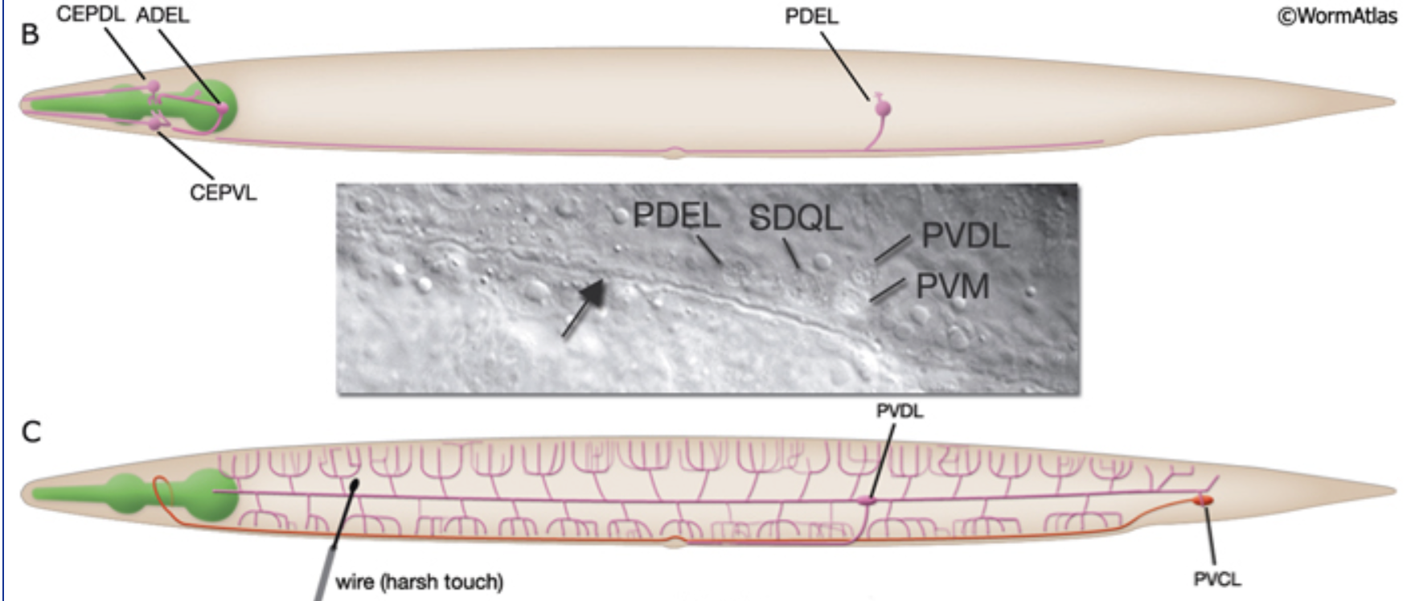
Introducing Neural Circuits
Sensory–Motor Integration Circuits
Circuits combine inputs from multiple senses
Interneurons integrate signals
Output = coordinated behavior
Notes:
Reflex arcs are the simplest case.
But circuits quickly get more complex when an organism needs to combine information from different senses.
Take C. elegans again: it doesn’t just respond to touch.
It has neurons for taste, smell, temperature, and mechanical pressure.
The interneurons act like hubs, pulling together signals from multiple sensory neurons and deciding what the worm should do.
For example, the worm might integrate chemical cues with touch to decide whether to keep moving forward or turn away.
This principle — combining inputs through interneurons — is a fundamental building block of nervous systems.
It’s how you get coordinated behaviors, not just simple reflexes.
In humans, this is scaled up enormously:
think of how your brain integrates sight, sound, and balance to let you walk across a crowded room without falling over.
So the next step beyond simple reflexes is integration:
circuits that don’t just pass signals forward, but combine them to generate more flexible responses.

Slide 7
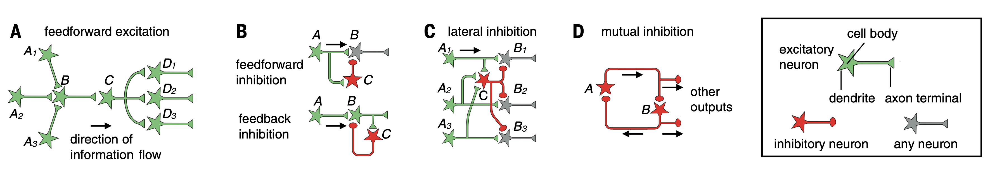
Types of Neural Circuits
Excitatory vs. Inhibitory Connections
Excitatory: increase activity in target neuron
Inhibitory: decrease activity in target neuron
Circuits balance both to control output
Notes:
Not all connections in a circuit do the same thing.
Some are excitatory: when one neuron fires, it increases the likelihood that the next one fires.
Others are inhibitory: they decrease that likelihood, damping down activity.
This balance of excitation and inhibition is crucial.
If you had only excitation, circuits would spiral out of control and fire endlessly.
If you had only inhibition, nothing would happen.
Circuits work because they combine both.
This is also one of Luo’s core ‘motifs’ that you read about — feedforward and feedback inhibition are everywhere.
They shape how long signals last, how strong they are, and they prevent circuits from going haywire.
Even in C. elegans, some neurons use glutamate to excite, and others use GABA to inhibit.
The balance of these inputs lets the worm’s motor neurons finely tune behaviors like forward vs. backward motion.

Slide 8
Types of Neural Circuits
Excitatory vs. Inhibitory Connections
Excitatory: increase activity in target neuron
Inhibitory: decrease activity in target neuron
Circuits balance both to control output
Notes:
Not all connections in a circuit do the same thing.
Some are excitatory: when one neuron fires, it increases the likelihood that the next one fires.
Others are inhibitory: they decrease that likelihood, damping down activity.
This balance of excitation and inhibition is crucial.
If you had only excitation, circuits would spiral out of control and fire endlessly.
If you had only inhibition, nothing would happen.
Circuits work because they combine both.
This is also one of Luo’s core ‘motifs’ that you read about — feedforward and feedback inhibition are everywhere.
They shape how long signals last, how strong they are, and they prevent circuits from going haywire.
Even in C. elegans, some neurons use glutamate to excite, and others use GABA to inhibit.
The balance of these inputs lets the worm’s motor neurons finely tune behaviors like forward vs. backward motion.

Slide 9
Types of Neural Circuits
Feedforward Circuits
Feedforward circuits regulate timing, strength, stability
Signals move in one direction
Example: worm touch → motor response
Notes:
Feedforward circuits are the simplest: information passes forward through each layer.
Take C. elegans again.
When the worm’s head is touched, mechanosensory neurons activate interneurons, which activate motor neurons.
The signal moves in one direction: input → processing → output.
This kind of feedforward flow ensures that signals move quickly and efficiently.
But it also regulates timing and strength.
Converging feedforward input can strengthen a signal, while diverging feedforward output can spread it to multiple motor neurons.
Luo describes this as one of the most common circuit motifs —
feedforward excitation and inhibition work together to sharpen responses and make sure they don’t last too long.

Slide 10
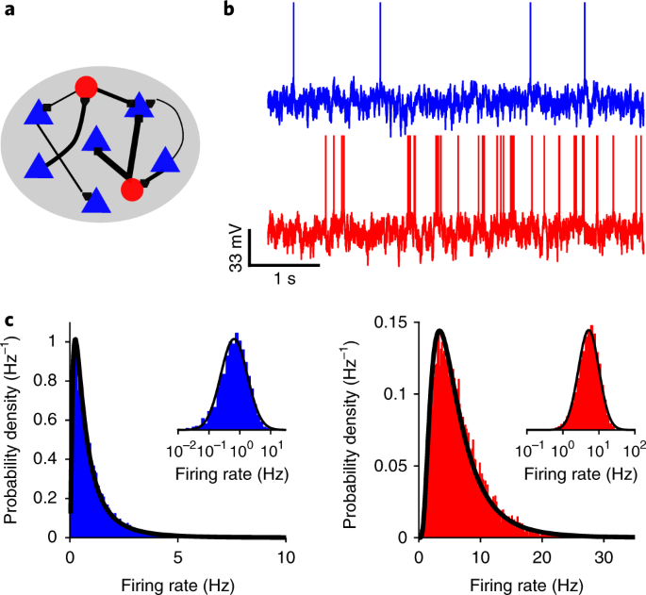
Types of Neural Circuits
Feedback Circuits
Feedback circuits regulate timing, strength, stability
Output loops back to earlier stage
Example: inhibition can gradually shut a circuit off
Notes:
Now let’s look at feedback. In feedback circuits, the output of a neuron loops back to influence earlier parts of the circuit.
One powerful example is feedback inhibition.
Suppose a sensory neuron excites a motor neuron, but at the same time,
it activates an inhibitory interneuron that feeds back onto the motor neuron.
At first the motor neuron fires strongly.
But as the feedback inhibition builds up, it reduces the firing, eventually shutting the motor neuron down.
This gradual increase in feedback is like an automatic shutoff.
It prevents circuits from staying locked in an ‘on’ state, and it keeps the system sensitive to new inputs.
You can also see how a similar feedback circuit can work as a timer -
allowing a certain type of activation to persist for a period of time (while the feedback signal builds up) –
and then shutting off when the feedback signal crosses a threshold.
Luo describes this as critical for keeping circuits balanced —
too much excitation without feedback leads to runaway activity, while feedback keeps things stable.

Slide 11
Types of Neural Circuits
Feedback Circuits
Feedforward inhibition: input excites inhibitor → sharpens response
Feedback inhibition: output activates inhibitor → prevents runaway
Lateral inhibition: neighbors inhibit each other → contrast, sharpening
Mutual inhibition: two units inhibit each other → winner-takes-all
Notes:
These are four common ways inhibition shows up in neural circuits.
Feedforward inhibition happens when an input excites both an excitatory target and an inhibitory interneuron that suppresses the target.
This sharpens timing.
For example, in the spinal cord, sensory input can excite motor neurons but also inhibitory interneurons that limit the duration of activation.
Feedback inhibition means the output of a neuron activates an inhibitory cell that circles back to suppress it.
This prevents runaway activity.
A classic example is Renshaw cells in the spinal cord: motor neurons activate them, and they feed inhibition right back to the same motor neuron.
Lateral inhibition is when neurons inhibit their neighbors.
This enhances contrast and sharpens sensory maps.
A famous example is in the retina: photoreceptor pathways inhibit neighboring cells, which helps edges ‘pop out’ in visual perception.
Mutual inhibition is when two units inhibit each other, so only one can be active at a time.
This creates a ‘winner-takes-all’ circuit. In C. elegans, mutual inhibition helps determine whether the worm goes forward or backward —
only one mode can dominate at once.
All four of these motifs are simple, but they give circuits powerful control over timing, strength, and competition.

Slide 12
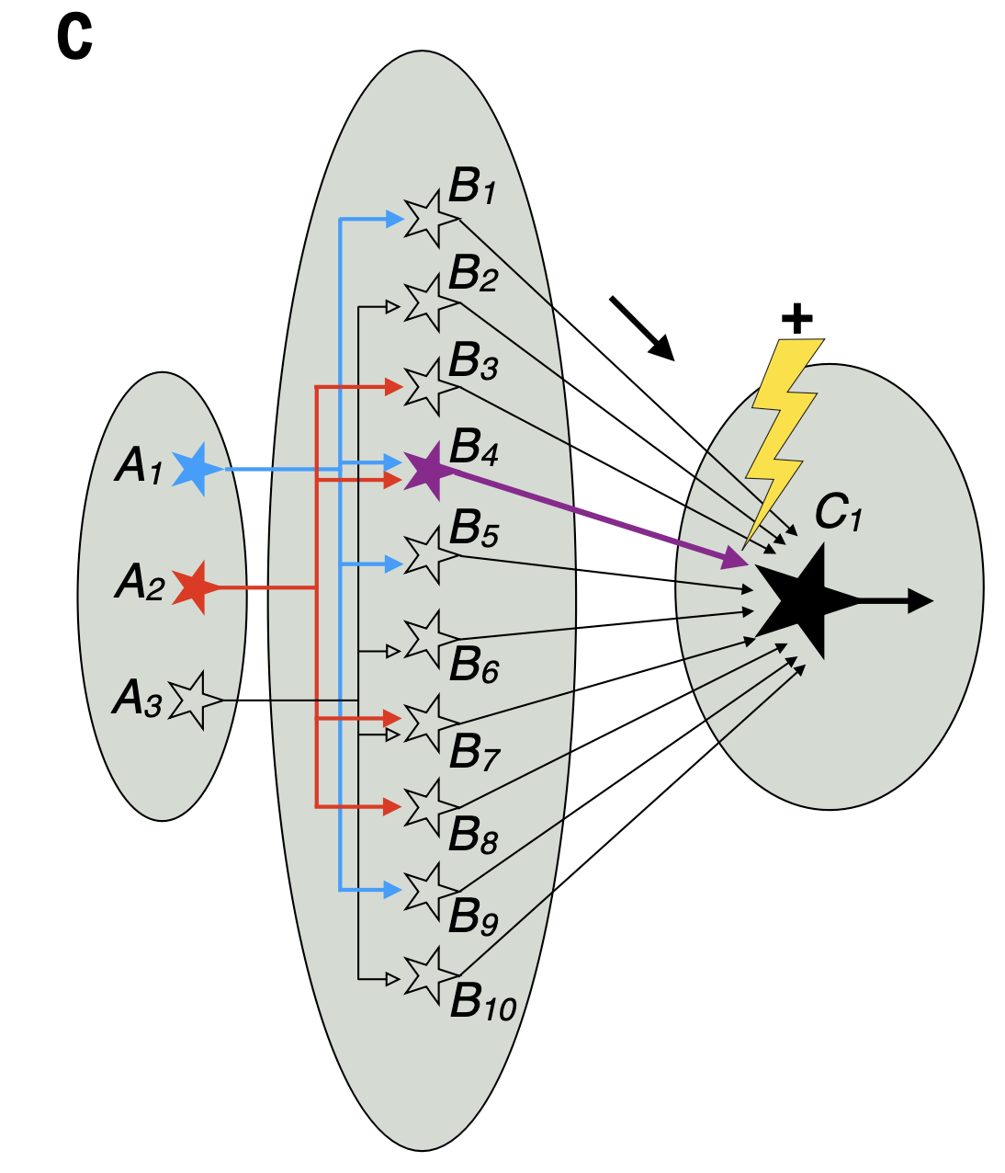
Types of Neural Circuits
Divergence and Convergence of Signals
Convergence: many inputs → one target
Divergence: one input → many targets
Enables integration & flexible output
Divergence
Convergence
Notes:
Another major principle of circuit design is convergence and divergence.
Convergence means multiple neurons connect to the same target neuron.
For example, in C. elegans, several sensory neurons might all connect to one interneuron.
That way, the interneuron integrates information and can respond more reliably than if it only listened to one input.
Divergence is the opposite — one neuron sends outputs to multiple targets.
That’s how a single sensory input can trigger different motor pathways at the same time.
Think of one odor-sensitive neuron in the worm activating several downstream interneurons,
each of which contributes to different movement choices.
Luo emphasizes that convergence improves signal-to-noise ratio, and divergence spreads the same information to many circuits.
Together, they allow flexible, adaptive responses.

Slide 13
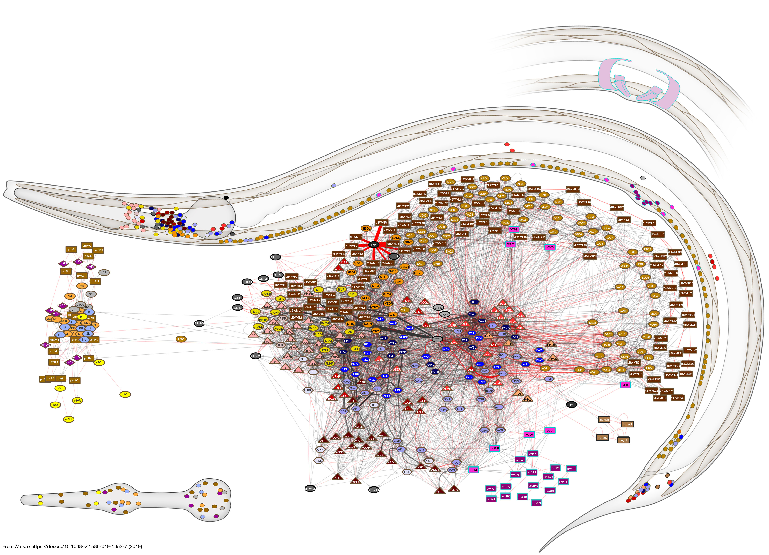
Mapping Neural Circuits
Connectomics Overview
Goal: map who connects to who
Tools: electron microscopy, tracing, imaging
Example: C. elegans connectome (302 neurons)
Notes:
To really understand circuits, neuroscientists need wiring diagrams —
what we call the connectome.
The connectome is the map of all the neurons and their connections.
In C. elegans, this is possible because the nervous system is so small — just 302 neurons.
Using electron microscopy, scientists painstakingly reconstructed every connection, creating the first complete connectome.
It showed us exactly how sensory neurons, interneurons, and motor neurons are linked.
For bigger brains, like ours, mapping circuits is much harder. Researchers use newer techniques —
viral tracers, fluorescent imaging, and large-scale electron microscopy —
but we’re still a long way from a complete human connectome.
Luo emphasizes that these mapping efforts are central to neuroscience today:
by knowing the structure, we can start asking how the patterns of connectivity create function and behavior.

Slide 14
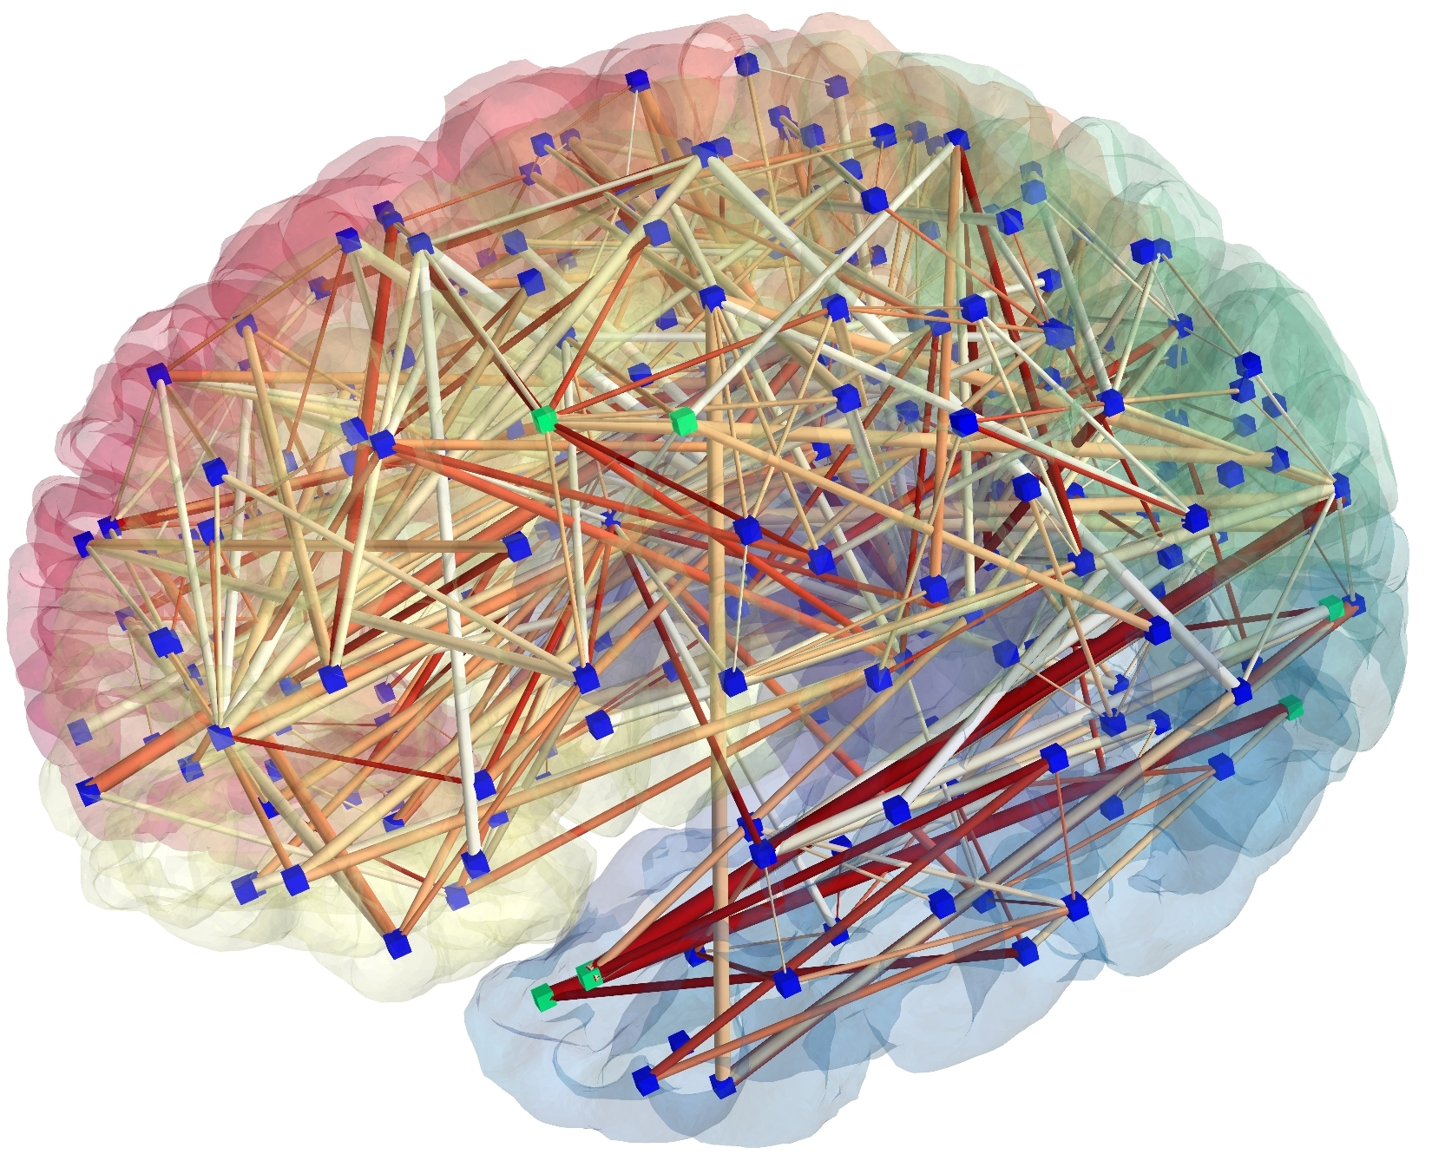
Mapping Neural Circuits
Human Connectomics
Human brain: ~86 billion neurons
fMRI & diffusion imaging map large-scale networks
Examples: default mode network, language network,
Notes:
In humans, we obviously can’t reconstruct the wiring of every single neuron.
Instead, cognitive neuroscientists use tools like fMRI and diffusion imaging to measure large-scale activity and connections.
From this, researchers build network models of the human brain.
Instead of single neurons, the nodes are brain regions, and the edges are the pathways or correlations between them.
One well-known example is the default mode network.
It’s a set of regions — including medial prefrontal cortex and posterior cingulate cortex —
that tend to be active together when we’re daydreaming, remembering, or imagining the future.
So while worm connectomics gives us a neuron-by-neuron map, human connectomics works at the scale of networks.
Both approaches try to answer the same core question: how does the wiring of the brain give rise to function?

Slide 15
Mapping Neural Circuits
Example Human Brain Networks:
Default Mode Network (DMN)
Dorsal Attention Network (DAN)
Ventral Attention Network (VAN)
Salience Network (SN)
Central Executive Network (CEN)
Limbic Network
Somatomotor Network
Visual Network
Notes:
These are some of the large-scale networks neuroscientists see in the human brain.
The Default Mode Network is active during rest and internal thought, like daydreaming or remembering.
The Dorsal Attention Network helps with goal-directed, top-down attention — focusing where you choose.
The Ventral Attention Network supports stimulus-driven, bottom-up attention — noticing unexpected things.
The Salience Network detects important or emotional events and helps the brain switch between internal and external focus.
The Central Executive Network is for working memory and decision making — planning, problem solving.
The Limbic Network links emotion and memory, involving regions like the hippocampus and amygdala.
The Somatomotor Network controls movement and bodily sensations.
And the Visual Network handles processing of visual information, from edges and colors up to faces and objects.
Together, these networks give us a picture of the brain as a set of dynamic, interacting systems, not just isolated regions.

Slide 16
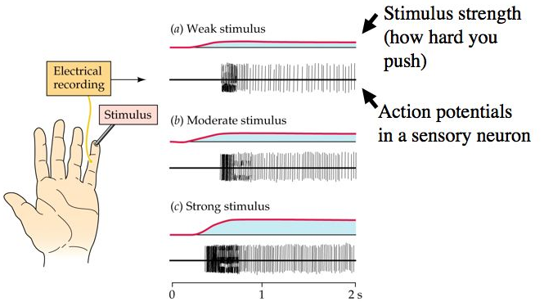
Mapping Neural Circuits
Neurons as Rate-Based Systems
Real neurons signal by firing rates
Spikes → average rate over time
Not just “on” or “off”
Notes:
So far, many of our diagrams have looked like neurons are little on/off switches — either firing or not firing.
But in real neuroscience, things are more graded.
Neurons communicate with spikes, but what really matters is the rate of firing over a window of time.
If a neuron fires more spikes per second, that’s interpreted as a stronger signal. If it fires fewer, that’s a weaker signal.
Think of it like the brightness of a lightbulb.
It’s not just whether the bulb is on or off, but how bright it is. Similarly, neurons carry information in their firing rates.
This is important because later, when we talk about neurons as logic gates, we’ll be simplifying —
talking as though they’re binary.
That abstraction is useful for understanding computation, but it’s not the whole story.
Firing rates remind us that real brains operate in a continuous, noisy, analog world.

Slide 17
Why Circuits Matter: From Neurons to Computation
Why Circuits Matter
Circuits transform inputs into outputs
Enable reflexes, rhythms, learning, thought
Foundation for brain computation
Notes:
Why spend so much time on circuits? Because they’re the bridge between single neurons and the whole brain.
A single neuron can process input and send an output, but real behavior requires groups of neurons working together.
Circuits allow us to:
Transform inputs into useful outputs.
Create reflexes that protect us.
Generate rhythms like breathing or walking.
Integrate multiple senses into one decision.
And eventually, support higher functions like memory, reasoning, and thought.
This is why Luo calls circuits the ‘words’ of the nervous system.
If neurons are the letters, circuits give us the building blocks of meaning.
They’re the units of computation the brain uses to get from sensation to action.

Slide 18
Why Circuits Matter: From Neurons to Computation
Wrap-Up & What’s Next
Today:
what neural circuits are & why they matter
Key motifs: excitation, inhibition, feedback, convergence
Circuits = “words” of the brain
Next: how circuits adapt and learn from experience
Notes:
Today we asked: what are neural circuits, and why are they important?
We looked at simple reflex arcs in C. elegans, how multiple sensory signals are integrated,
and how circuits generate rhythms and fast escape responses.
We also saw motifs like excitation and inhibition, feedforward and feedback, convergence and divergence.
The big idea is that circuits are the building blocks of brain computation — the ‘words’ that make up the sentences of the brain.
But circuits aren’t fixed. They can adapt and learn.
Next time, we’ll look at how sensory systems adjust when stimulation continues,
how connections strengthen or weaken with use, and how this leads to learning —
from Hebb’s famous rule to classical conditioning. That’s where we’ll pick up.

